Slide 1
8
Experimental Research Design

Slide 2
Introduction
Research design
the outline, plan, or strategy used to investigate the research problem
Purpose of research design
control for unwanted variation
suggests how data will be statistically analyzed
Goal of research design
choose the strongest design that is possible, ethical, and feasible

Slide 3
Weak Experimental Designs
Designs that do not control for many extraneous variables and provide weak evidence of cause and effect
Only use when a stronger design cannot be used to answer the research question

Slide 4
Weak Experimental Designs
One-group posttest-only design
administration of a posttest to a single group of participants after they have been given an experimental treatment condition
rarely useful because no pretest or control group
almost all threats to internal validity apply
is useful only when specific background information exists on the dependent variable

Slide 5
Weak Experimental Designs
One-group pretest-posttest design
design in which a treatment condition is interjected between a pretest and posttest of the dependent variable
most threats to internal validity exist
to infer causality must identify and demonstrate that internal validity threats do not exist

Slide 6
One-Group Pretest-Posttest Design
Example
O = students’ reading measured at beginning of school year
X = new reading curriculum employed throughout school year
O = students’ reading measured at the end of the school year
threats to internal validity not controlled for
history, testing, regression, instrumentation, and maturation

Slide 7
Weak Experimental Designs
Posttest-only design with nonequivalent groups
design in which the performance of an experimental group is compared with that of a nonequivalent control group at the posttest
internal threats addressed include history, maturation, regression, and attrition
no assurance of equality of groups because they were not randomly assigned
may confound selection with treatment effect
selection additive and interactive effects also may be present

Slide 8
Posttest-Only Design with Nonequivalent Groups Example
Experimental group = School A adopts new reading curriculum (X)
Control group = School B uses old reading curriculum
Both schools posttest reading at the end of the year (O)

Slide 9
Strong Experimental Designs
Designs that effectively control extraneous variables and provide strong evidence of cause and effect
Improved internal validity achieved by eliminating rival hypotheses
with control techniques
most important is random assignment
with a control group
group that does not get the independent variable or gets some standard value
serves as source of comparison to experimental group
controls for rival hypothesis
Experimental group
the group of participants that receives the treatment condition that is intended to produce an effect

Slide 10
Between-Participants Designs
Different groups are exposed to the different levels of the independent variable
participants are randomly assigned to groups
Posttest-only control-group design
random assignment to groups creates equivalence
use of control group eliminates most threats to internal validity
weaknesses of design
does not guarantee equivalence of groups – particularly with small sample size (N < 30)
no pretest to assess equivalence

Slide 11
Posttest-Only Control-Group Design
Example
participants randomly assigned to groups
IV = Social Skills Training
experimental group – received social skills training (X)
control group – receives no social skills training
DV = posttest measure (O) for both groups

Slide 12
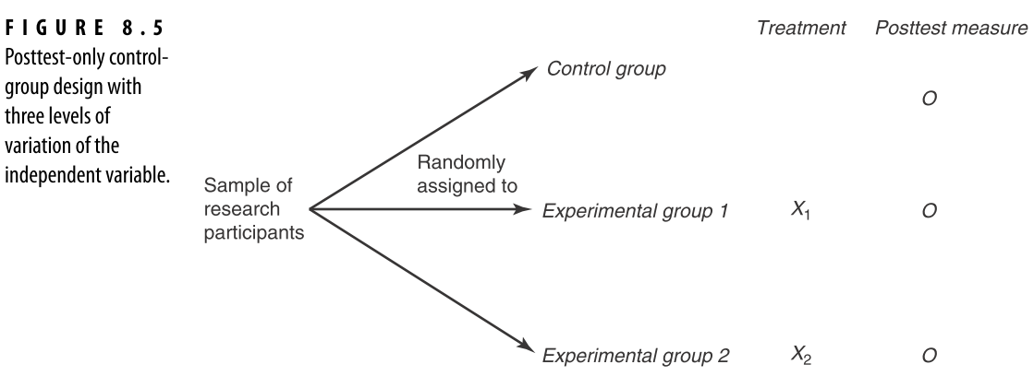
Posttest-Only Control-Group Design with Three Groups

Slide 13
Within-Participants Designs
Participants included in all conditions (also known as repeated measures designs)
Counterbalancing necessary to eliminate linear sequencing effects
Within-participants posttest-only design
all participants receive all conditions, and a posttest is administered after each condition is administered

Slide 14
Within-Participants Posttest-Only Design
Insert figure 8.6 and figure 8.7 from textbook
If possible both on this side of the slide
If not then example on slide by itself first, then both figures on one slide together second
Example (Mahoney, et al., 2005)
participants = elementary school children
IV = breakfast type
cereal, oatmeal, no breakfast
each type on three different days
DV = cognitive performance
series of cognitive tasks after breakfast

Slide 15
Within-Participants Designs
Strengths
increased sensitivity because effects of individual differences are controlled
fewer research participants needed
Weaknesses
difficult for participants
potential problem of differential carryover effects

Slide 16
Mixed Designs
Contains both between participants and within participants variables
Pretest-Posttest Control-Group Design
pretest added to posttest-only control-group design
between participants variable = variable of interest
within participants variable = time (pretest and posttest)

Slide 17
Pretest-Posttest Control-Group Design

Slide 18
Pretest-Posttest Control-Group Design
Pretest for social anxiety
Random assignment of 100 participants with social anxiety
IV = treatment for social anxiety
experimental group = anxiety reduction treatment (N = 50)
control group = no anxiety reduction treatment (N = 50)
DV = level of social anxiety (posttest)
Results
Insert figure 8.9 from textbook

Slide 19
Mixed Designs
Pretest-posttest control-group design
advantages of including a pretest
can assess the effects of randomization
insure that groups are equivalent on dependent variable prior to introduction of experimental conditions
determine if ceiling or floor effect has occurred
allows use of analysis of covariance to statistically control for pretest differences
allows researcher to assess the change in dependent variable from pretest to posttest
Disadvantage of including a pretest
may not generalize to situations with no pretest

Slide 20
Factorial Designs
Two or more IVs are studied to determine their separate and joint effects on the DV
They can include:
only between participants variables
only within participants variables
both between and within participants variables (mixed design)
Design layout
a picture or table showing the logical structure of a factorial design

Slide 21
Factorial Design Layout Example
 |  | Caffeine Consumption
 |  | low | medium | high
Sleep Deprivation | not deprived | low not deprived | medium not deprived | high not deprived
 | deprived | low deprived | medium deprived | high deprived
Notes:
This is to show the students the design elements of the factorial combination before introducing the analysis elements

Slide 22
Factorial Design
Design layout and analysis
cell
combination of levels of two or more independent variables
cell mean
the average score of the participants in a single cell
marginal mean
the average score of all participants receiving one level of an independent variable

Slide 23
Factorial Design Layout with Analysis

Slide 24
Factorial Designs
Main effect
the influence of one independent variable on the dependent variable
ignoring the second IV
one main effect for each IV in a study
Interaction effect
the joint, combined, or “interactive” effect of two or more independent variables on the dependent variable
i.e., when the effect of one independent variable depends on another
when displayed graphically, an interaction yields non-parallel lines

Slide 25
Factorial Design Example
DV = driving performance or number of correct maneuvers
Main effect of sleep deprivation
not deprived = more correct maneuvers
Main effect of caffeine
medium caffeine consumption most correct maneuvers

Slide 26
Line Graph of Interaction
Interaction effect between sleep deprivation and caffeine consumption
gives us more information than main effects
if deprived of sleep, the more caffeine the better when it comes to driving performance
if not deprived of sleep, medium levels of caffeine consumption increases deriving performance the most

Slide 27
Factorial Design Notation
2 x 2 design
number of numerals = number of IVs = 2
each number indicates the number of levels for each IV
IV1 = 2 levels
IV2 = 2 levels
2 x 3 design
2 IVs
IV1 = 2 levels
IV2 = 3 levels

Slide 28
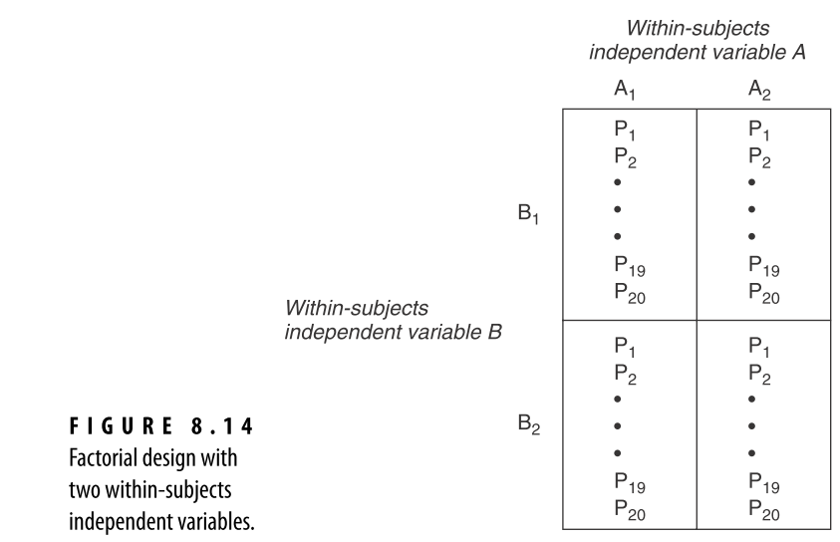
Within Participants Factorial Design

Slide 29
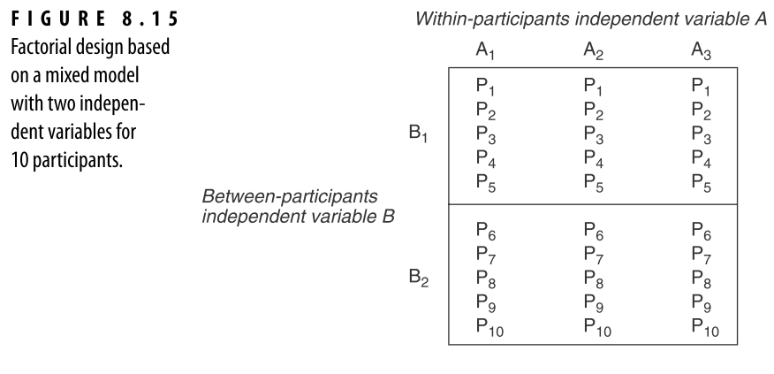
Mixed Model Factorial Design

Slide 30
Strengths and Weaknesses of Factorial Designs
Strengths
more than one independent variable allows for more precise hypotheses
control of extraneous variables by including as an independent variable
ability to determine the interactive effect of two or more independent variables

Slide 31
Strengths and Weaknesses of Factorial Designs
Weaknesses
using more than two independent variables may be logistically cumbersome
examples
2 x 2 design = 4 cells, 2 main effects, and 1 interaction
2 x 3 design = 6 cells, 2 main effects, and 1 interaction
2 x 2 x 3 design = 12 cells, 3 main effects, and 4 interactions
higher-order interactions are difficult to interpret

Slide 32
Choice/Construction of the Appropriate Experimental Design
Examination of prior research literature can guide choice of design
Many factors to consider
use of control group
number of comparison groups
pretest(s)
within-participants or between-participants
number of independent and dependent variables

